Slide 1
Algorithms Complexity of Sorting
CSE 464/574
Spring 2019

Slide 2
Complexity of Sorting
Computational complexity.
Framework to study efficiency of algorithms for solving a particular problem X.
Model of computation.
Allowable operations.
Cost model.
Operation count(s).
Upper bound.
Cost guarantee provided by some algorithm for X.
Lower bound.
Proven limit on cost guarantee of all algorithms for X.
Optimal algorithm.
Algorithm with best possible cost guarantee for X.
lower bound ~ upper bound

Slide 3
Decision tree
Suppose that we are sorting 3 records with keys key₁, key₂, and key₃.
We are assuming that we are sorting by comparison of values.
What decisions do we need to make?
Level 1: key₁ < key₂
_{yes no}
Level 2: key₂ < key₃ key₁ < key₃
_{yes no yes no}
Level 3: key₁, key₂, key₃. key₁ < key₃ key₂, key₁, key₃. key₂ < key₃
_{yes no yes no}
Level 4: key₁, key₂, key₃ key₃, key₁, key₂. key₂, key₃, key₁. key₃, key₂, key₁.

Slide 4
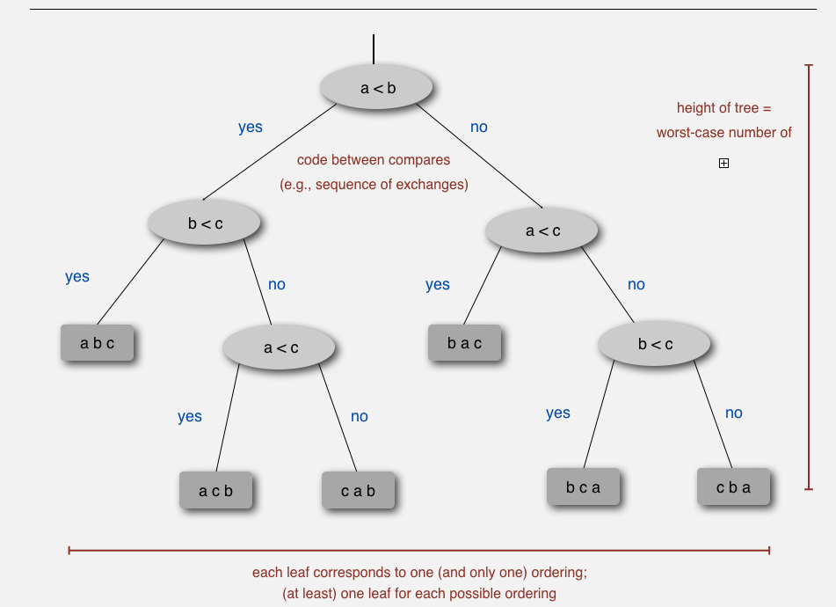

Slide 5
Compare-based lower bound for sorting
Proposition. Any compare-based sorting algorithm must use at least lg ( N ! ) ~ N lg N compares in the worst-case.
Proof
Assume array consists of N distinct values a₁ through a_{N}.
Worst case dictated by height h of decision tree.
Binary tree of height h has at most 2^{h} leaves.
N ! different orderings ⇒ at least N ! leaves.

Slide 6
Compare-based lower bound for sorting
Proposition. Any compare-based sorting algorithm must use at least lg ( N ! ) ~ N lg N compares in the worst-case.
Proof:
Assume array consists of N distinct values a₁ through a_{N}.
Worst case dictated by height h of decision tree.
Binary tree of height h has at most 2^{h} leaves.
N ! different orderings ⇒ at least N ! leaves.
2 ^{h} ≥ # leaves ≥ N !
⇒ h ≥ lg ( N ! ) ~ N lg N
Stirling's formula

Slide 7
Complexity of sorting
Model of computation. Allowable operations.
Cost model. Operation count(s).
Upper bound. Cost guarantee provided by some algorithm for X.
Lower bound. Proven limit on cost guarantee of all algorithms for X.
Optimal algorithm. Algorithm with best possible cost guarantee for X.
Example: sorting.
Model of computation: decision tree.
Cost model: # compares.
Upper bound: ~ N lg N from mergesort.
Lower bound: ~ N lg N.
Optimal algorithm = mergesort.
First goal of algorithm design: optimal algorithms.

Slide 8
Complexity results in context
Compares? Mergesort is optimal with respect to number compares.
Space? Mergesort is not optimal with respect to space usage.
Lower bound may not hold if the algorithm can take advantage of:
The initial order of the input. Ex: insert sort requires only a linear number of compares on partially-sorted arrays.
The distribution of key values. Ex: 3-way quicksort requires only a linear number of compares on arrays with a constant number of distinct keys.
The representation of the keys. Ex: radix sort requires no key compares — it accesses the data via character/digit compares.

